Slide 1


Deployment of a Time-Triggered Architecture schedule redundant Real-Time Embedded System
Group 1 students:
Akhil Gopinath Santha Rick Scholten
Kenneth Kuijpers Parya Pourebrahim
Radu Ursachi Yaxin Feng
Rares Birjac

Slide 2
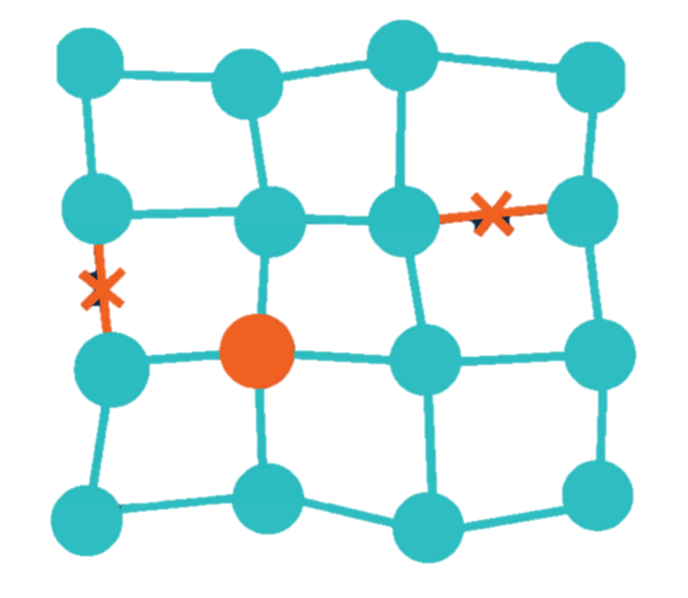
Content
Project Objectives
Hardware setup
Software architecture
Test Plan
Results
Discussion
Conclusion and recommendations

Slide 3
Project Objectives
Highly available control system
Triple modular redundancy
Fault redundant architecture
Test scenarios
Develop

Slide 4
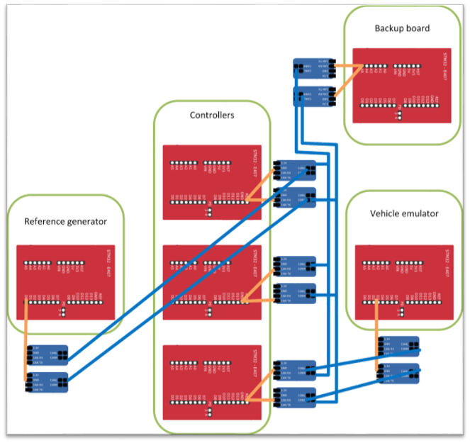
Hardware setup

Slide 5

Hardware setup: Backup Board
Results from comparer
Board that doesn’t agree
Take over ID of not agreeing board
Get all controller calculations

Slide 6
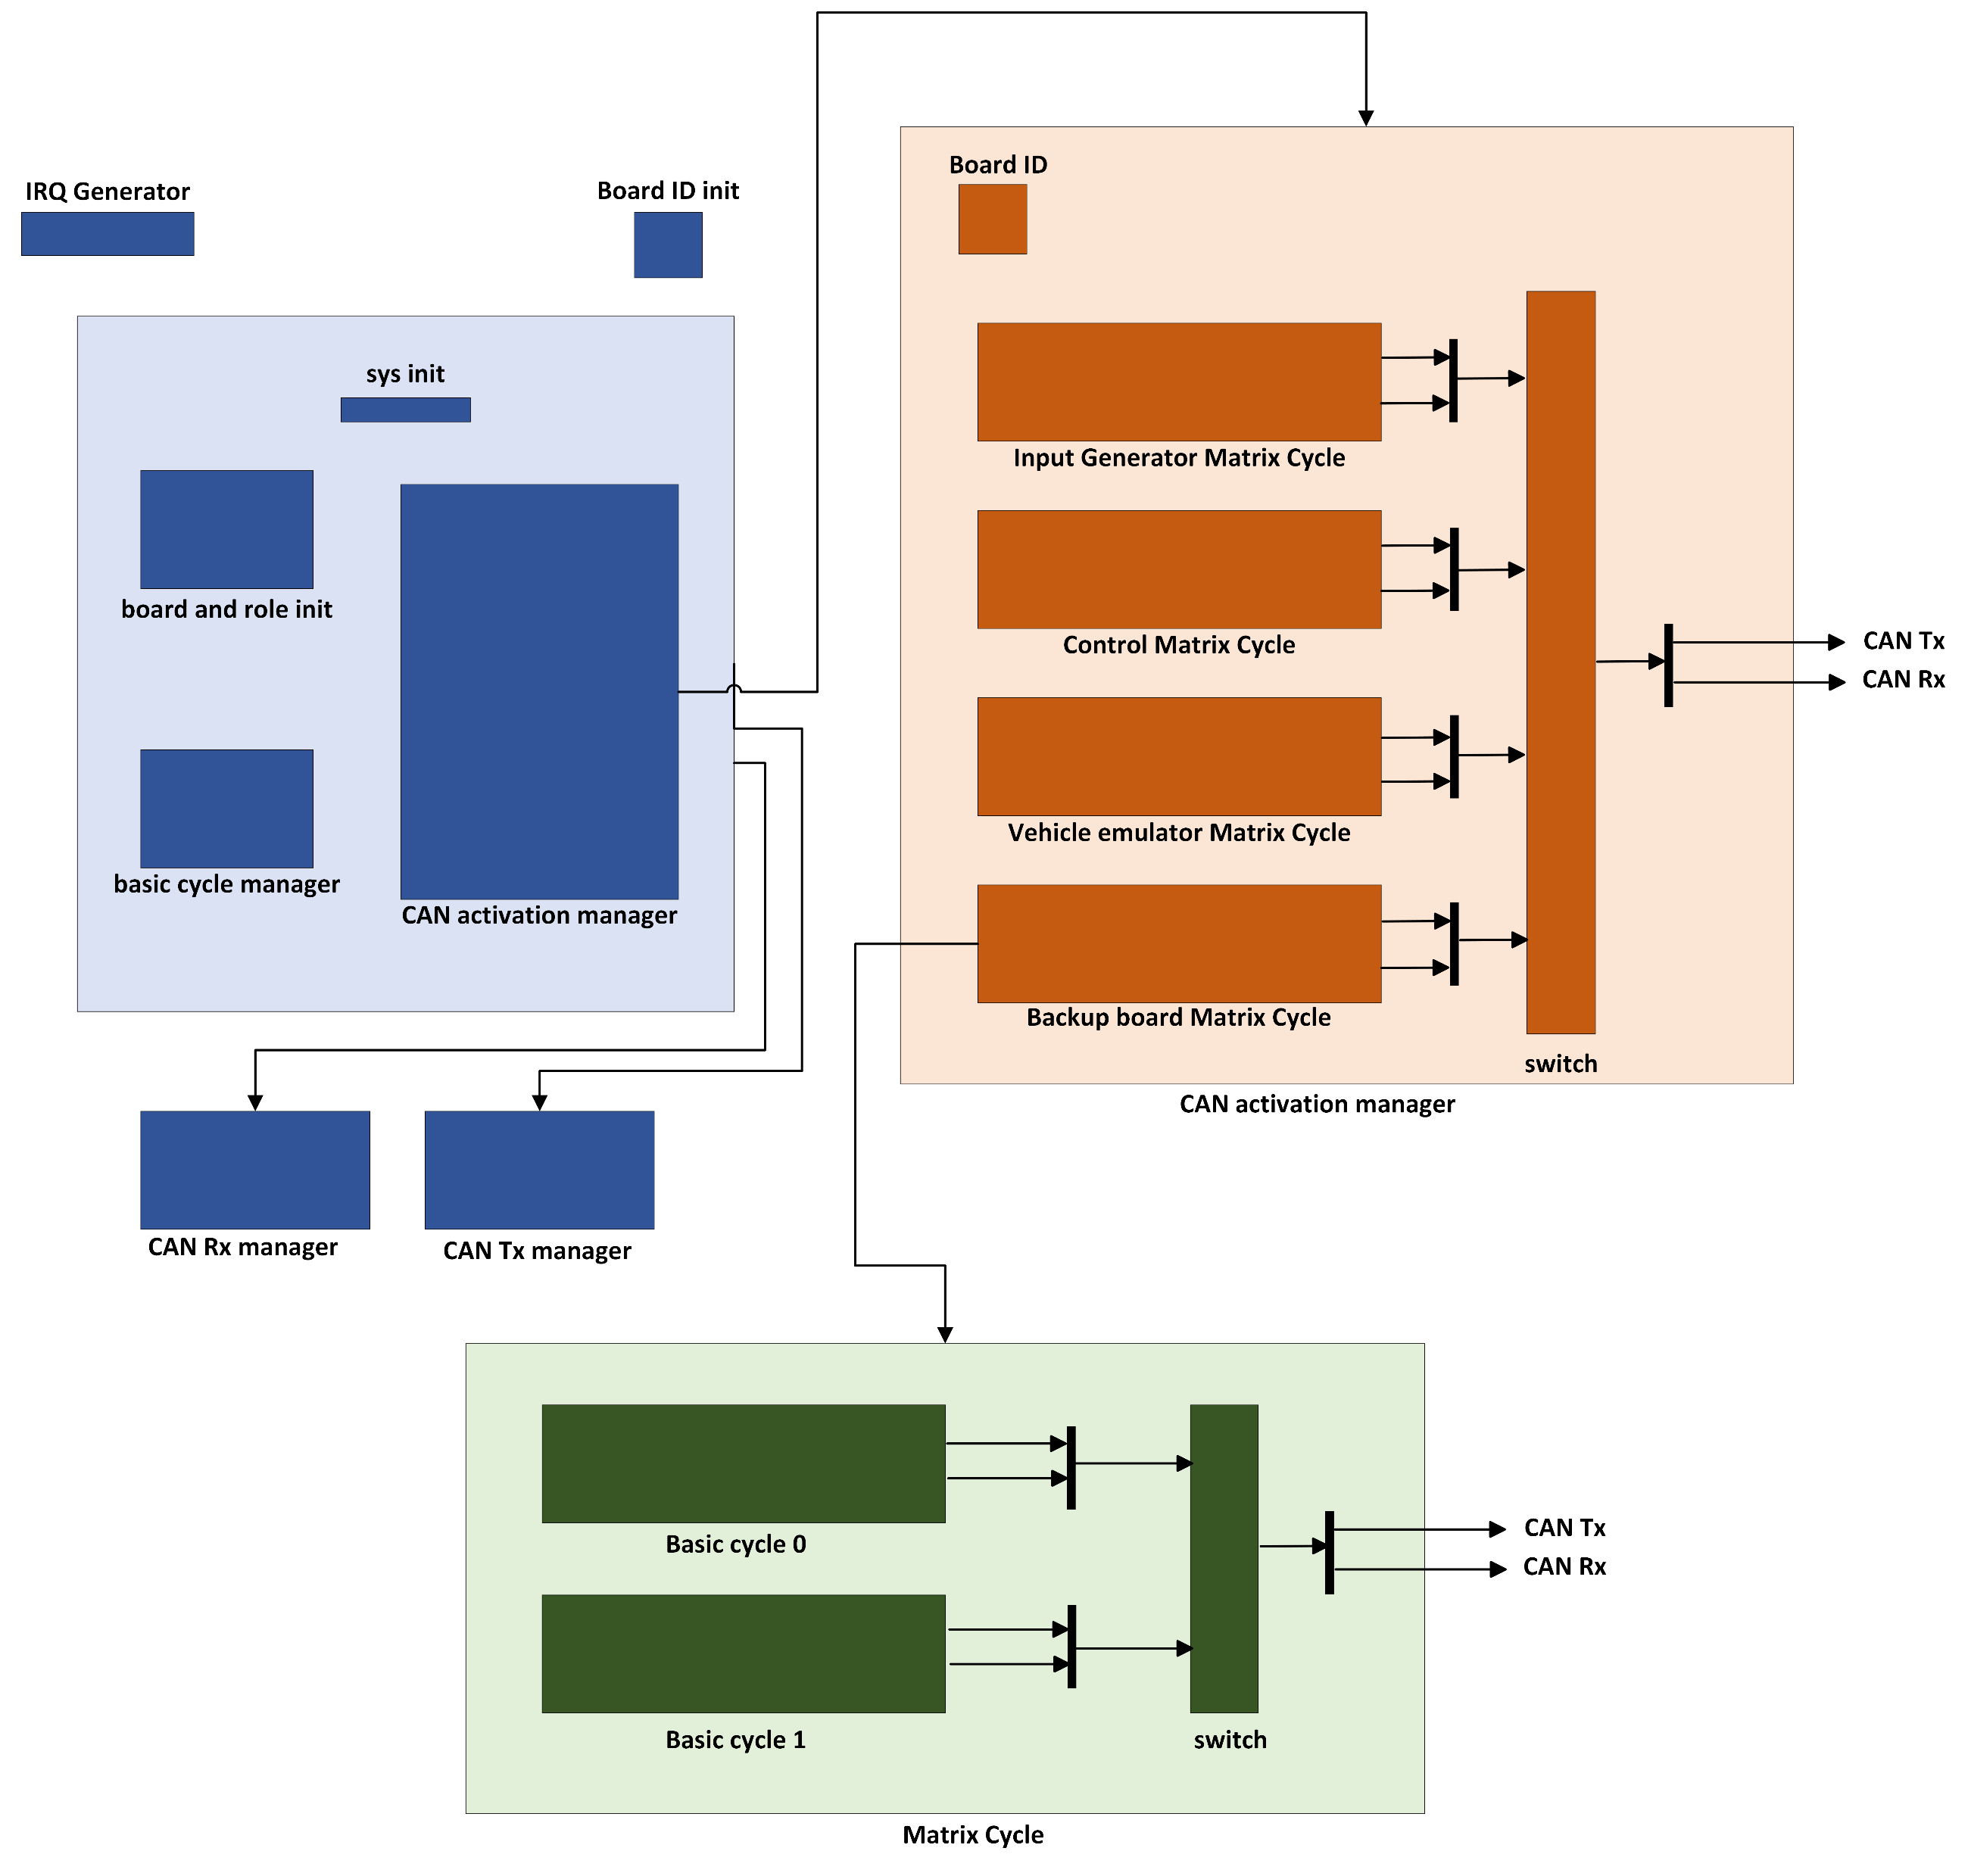
Software setup

Slide 7
Software setup: Controller Matrix Cycle – Basic Cycle 0
Check COMM
TW 1
Update LT
TW 2
Vote 1
TW 4
Check COMM
TW 5
Vote 2
TW 7
Check COMM
TW 8
Count Vote 2
TW 9
Vote 3
TW 10
Check COMM
TW 11
Check Timeouts
TW 13
Reset Board
TW 16
Sync bc1
TW 0
Vote Decision
TW 3
Count Vote 1
TW 6
Count vote 3
TW 12
New Master
TW 14
Reset Variables
TW 15
COMM
COMP

Slide 8
Software setup: Controller Matrix Cycle – Basic Cycle 1 addition
Check COMM
TW 1
Update LT
TW 2
Set Values
TW 3
Check COMM
TW 4
Sensor Values
TW 5
Check COMM
TW 6
Steer
TW 7
Torque
TW 8
Velocity
TW 9
Output Controller 1
TW 10
Check COMM
TW 11
Output Controller 2
TW 12
Check COMM
TW 13
TMR
TW 16
Check COMM
TW 18
Output Master
TW 14
Output Emulator
TW 17
Sync bc1
TW 0
Reset Variables
TW 19
Check COMM
TW 15
COMM
COMP

Slide 9
Software setup: Basic cycle 0 – created for the back-up board
Check COMM
TW 1
Update LT
TW 2
TW 4
TW 5
TW 7
TW 8
TW 9
TW 10
TW 11
TW 13
Sync bc1
TW 0
Check TO and reset TW 3
TW 6
TW 12
TW 14
Reset variables TW 15
TW 16
COMM
COMP

Slide 10
Software setup: Basic cycle 1 – created for the back-up board
Check COMM
TW 1
Update LT
TW 2
TW 4
TW 5
TW 7
TW 8
TW 9
Receive Controller 1
TW 10
Check COMM
TW 11
Check COMM
TW 13
Determine Broken Board
TW 16
Sync bc1
TW 0
TW 3
TW 6
Receive Controller 2
TW 12
Receive Master
TW 14
Check COMM
TW 15
TW 17
TW 18
Check TO and reset
TW 19
COMM
COMP

Slide 11

Software setup: TMR
Controller boards – master board
​
​1 calculate output values
2 receive calculations from other boars
3 check if all values are within range of each other​
4 check agreements and set output, otherwise set 0​ [TMR main] If 1+2 or 2+3 or 1+3 agree, this value is shifted to output​
5 Create error byte so everything can be checked in HANtune
6 Send TMR output to vehicle (emulator)

Slide 12
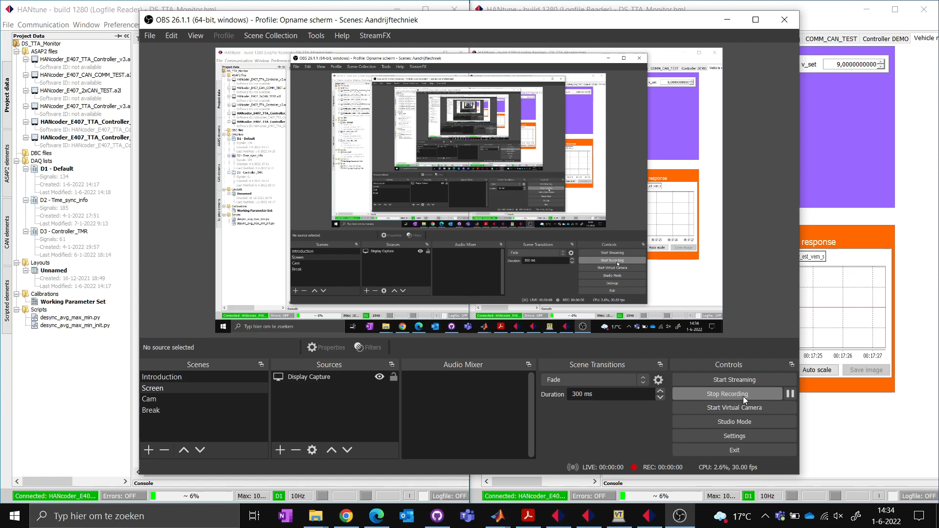
Testing and the Result
Test old code to verify hardware connections
Add a board to the initial code with ID 0 and check its interference

Slide 13
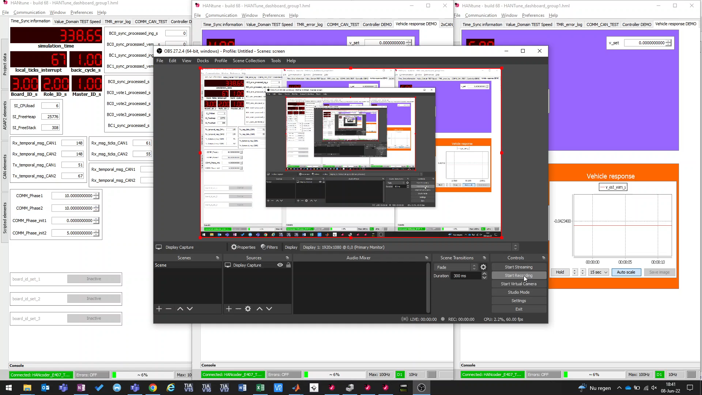
Testing and the Result
3. Test the updated controller board code to see if this is still working without backup board connected.
4. Test the updated controller board code to see if this is still working with backup board connected. (functions the same)

Slide 14
Testing and the Result
5. Force two controller boards with the same ID
6. Test if the backup board's matrix cycle timing is working, so if the basic cycles are parallel with the others.

Slide 15
Testing and the Result
7. Test if the backup board is receiving all controller board messages.
8. Test if the backup board overtakes another controller board when this brakes.
9. Test if the backup board keeps functioning when it already took over a broken controller board and a second board breaks.
10. Test if the TMR is working the same as before when the backup board has taken over a broken board.

Slide 16
Discussions
Sensitive for failure of one of the two CAN busses.
If there is one device jamming, the whole system is down.
Test Result

Slide 17
Conclusions
Add an extra board
Highly Available
Fault tolerant
Membership Function
Triple Modular Redundancy

Slide 18
Recommendations
CAN bus can be made independent of each other

Slide 19
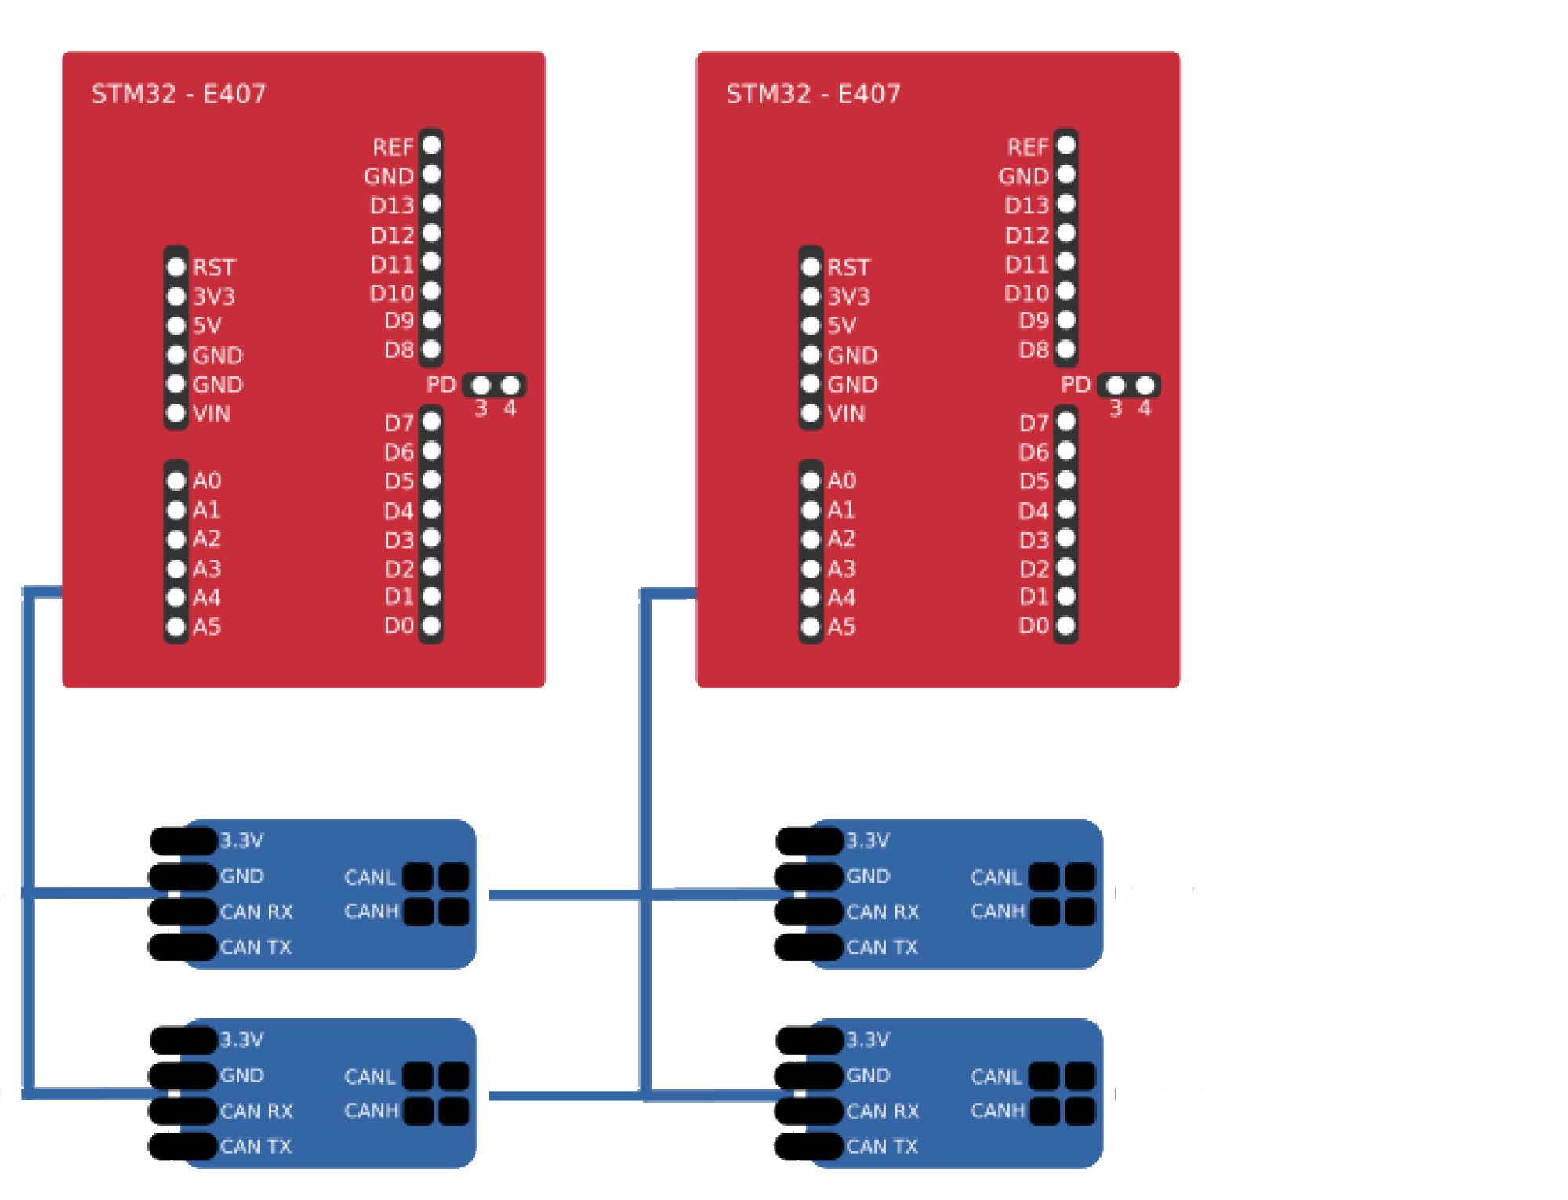
Thanks for your attention

Slide 20

Questions?

Slide 21
Extra Information 1
GitHub Repository Link:
https://github.com/parya-pourebrahim/Distributed-System---HAN

Slide 22
Extra Information 2

Slide 23

Test Plan:
Basic functioning of the back-up board, change ID, reading out master, etc.​
Functioning of the adapted time windows​
Check length of the basic cycles​
Failure of controller simulation​
Check if communication still functions with back-up board​
Check functioning of back-up board in new “position”​
Check if voter still functions with back-up board​

